Slide 1
Dynamic Programming (DP)
Like divide-and-conquer, solve problem by combining the solutions to sub-problems.
Unlike divide-and-conquer, in DP
  Sub-problems are dependent, i.e., sub-problems share sub-sub-problems, every sub(sub)problem solved just once, solutions to sub(sub)problems are stored in a table and used later.
1

Slide 2
Typical steps of DP
Characterize the structure of an optimal solution.
Recursively define the value of an optimal solution.
Compute the value of an optimal solution in a bottom-up fashion.
Compute an optimal solution from computed/stored sub-problem solutions.

Slide 3
Matrix-chain multiplication (MCM) -DP
Problem: given <A₁, A₂, …,A_{n}>, compute the product: A₁×A₂×…×A_{n} , find the fastest way (i.e., minimum number of multiplications) to compute it.
Suppose two matrices A(p,q) and B(q,r), compute their product C(p,r) in p × q × r multiplications
  for a=1 to p
    for b=1 to r
      C[a,b]=0
      for c=1 to q
        C[a,b] = C[a,b]+ A[a,c]B[c,b]

Slide 4
Matrix-chain multiplication -DP
Different parenthesizations will have different number of multiplications for product of multiple matrices
Example: A(10,100), B(100,5), C(5,50)
  If ((A ×B) ×C), 10 ×100 ×5 +10 ×5 ×50 =7500
  If (A ×(B ×C)), 10 ×100 ×50+100 ×5 ×50=75000
The first way is ten times faster than the second !!!
Denote <A₁, A₂, …,A_{n}> by < p₀,p₁,p₂,…,p_{n}>
  i.e, A₁(p₀,p₁), A₂(p₁,p₂), …, A_{i}(p_{i-1},p_{i}),… A_{n}(p_{n-1},p_{n})

Slide 5
Matrix-chain multiplication –MCM DP
Intuitive brute-force solution: Counting the number of parenthesizations by exhaustively checking all possible parenthesizations.
Let P(n) denote the number of alternative parenthesizations of a sequence of n matrices:
  P(n) = 1 if n=1
  ∑_{k=1}^{n-1} P(k)P(n-k) if n≥2
The solution to the recursion is Ω(2^{n}).
So brute-force will not work for a large n.

Slide 6
MCM DP Steps
Step 1: structure of an optimal parenthesization
  Let A_{i..j} (i≤j) denote the matrix resulting from A_{i}×A_{i+1}×…×A_{j}
  Any parenthesization of A_{i}×A_{i+1}×…×A_{j} must split the product between A_{k} and A_{k+1} for some k, (i≤k<j). The
  cost = cost of A_{i..k} + cost of A_{k+1..j} + # A_{i..k} × A_{k+1..j.}
  If k is the position for an optimal parenthesization, the parenthesization of “prefix” subchain A_{i}×A_{i+1}×…×A_{k} within this optimal parenthesization of A_{i}×A_{i+1}×…×A_{j} must be an optimal parenthesization of A_{i}×A_{i+1}×…×A_{k.}
  A_{i}×A_{i+1}×…×A_{k} × A_{k+1}×…×A_{j}

Slide 7
MCM DP Steps (2)
Step 2: a recursive relation
  Let m[i,j] be the minimum number of multiplications for A_{i}×A_{i+1}×…×A_{j}
  m[1,n] will be the answer
  m[i,j] = 0 if i = j
  min {m[i,k] + m[k+1,j] +p_{i-1}p_{k}p_{j} } if i<j
i≤k<j

Slide 8
MCM DP Steps (3)
Step 3, Computing the optimal cost
  If by recursive algorithm, exponential time Ω(2^{n}) (ref. to P.346 for the proof.), no better than brute-force.
  Total number of subproblems: +n = Θ(n²)
  Recursive algorithm will encounter the same subproblem many times.
  If tabling the answers for subproblems, each subproblem is only solved once.
  The second hallmark of DP: overlapping subproblems and solve every subproblem just once. (the first hallmark is optimal substructure)
n
( )
2

Slide 9
MCM DP Steps (3-2)
Step 3, Algorithm,
  array m[1..n,1..n], with m[i,j] records the optimal cost for A_{i}×A_{i+1}×…×A_{j .}
  array s[1..n,1..n], s[i,j] records index k which achieved the optimal cost when computing m[i,j].
  Suppose the input to the algorithm is p=< p₀ , p₁ ,…, p_{n} >.

Slide 10
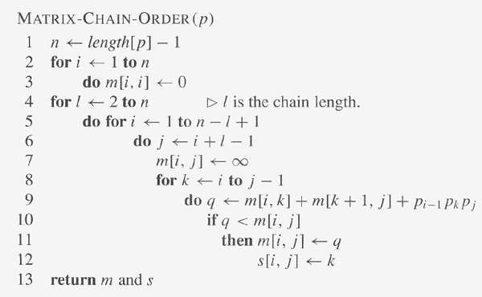
MCM DP Steps (3-3)

Slide 11
MCM DP—order of matrix computations
m(1,1) m(1,2) m(1,3) m(1,4) m(1,5) m(1,6)
m(2,2) m(2,3) m(2,4) m(2,5) m(2,6)
m(3,3) m(3,4) m(3,5) m(3,6)
m(4,4) m(4,5) m(4,6)
m(5,5) m(5,6)
m(6,6)

Slide 12
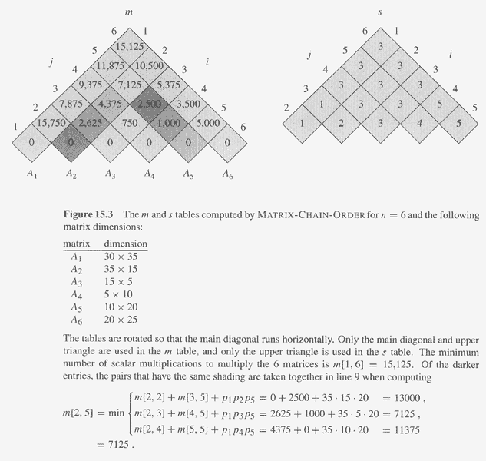
MCM DP Example

Slide 13
MCM DP Steps
Step 4, constructing a parenthesization order for the optimal solution.
  Since s[1..n,1..n] is computed, and s[i,j] is the split position for A_{i}A_{i+1}…A_{j} , i.e, A_{i}…A_{s[i,j]} and A_{s[i,j] +1}…A_{j} , thus, the parenthesization order can be obtained from s[1..n,1..n] recursively, beginning from s[1,n].

Slide 14
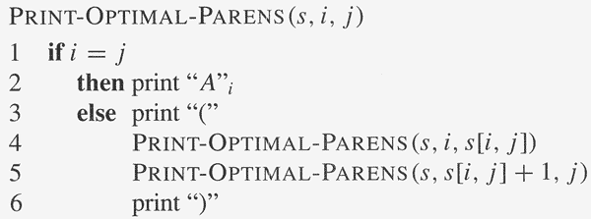
MCM DP Steps
Step 4, algorithm

Slide 15
Elements of DP
Optimal (sub)structure
  An optimal solution to the problem contains within it optimal solutions to subproblems.
Overlapping subproblems
  The space of subproblems is “small” in that a recursive algorithm for the problem solves the same subproblems over and over. Total number of distinct subproblems is typically polynomial in input size.
(Reconstruction an optimal solution)

Slide 16
Finding Optimal substructures
Show a solution to the problem consists of making a choice, which results in one or more subproblems to be solved.
Suppose you are given a choice leading to an optimal solution.
  Determine which subproblems follows and how to characterize the resulting space of subproblems.
Show the solution to the subproblems used within the optimal solution to the problem must themselves be optimal by cut-and-paste technique.

Slide 17
Characterize Subproblem Space
Try to keep the space as simple as possible.
In assembly-line schedule, S_{1,j} and S_{2,j} is good for subproblem space, no need for other more general space
In matrix-chain multiplication, subproblem space A₁A₂…A_{j} will not work. Instead, A_{i}A_{i+1}…A_{j} (vary at both ends) works.

Slide 18
A Recursive Algorithm for Matrix-Chain Multiplication
RECURSIVE-MATRIX-CHAIN(p,i,j) (called with(p,1,n))
if i=j then return 0
m[i,j]←∞
for k←i to j-1
do q← RECURSIVE-MATRIX-CHAIN(p,i,k)+ RECURSIVE-MATRIX-CHAIN(p,k+1,j)+p_{i-1}p_{k}p_{j}
if q< m[i,j] then m[i,j] ←q
return m[i,j]
The running time of the algorithm is O(2^{n}). Ref. to page 346 for proof.

Slide 19
Recursion tree for the computation of RECURSIVE-MATRIX-CHAIN(p,1,4)
1..4
1..1
2..4
1..2
3..4
1..3
4..4
2..2
3..4
2..3
4..4
1..1
2..2
3..3
4..4
1..1
2..3
1..2
3..3
3..3
4..4
2..2
3..3
2..2
3..3
1..1
2..2
This divide-and-conquer recursive algorithm solves the overlapping problems over and over.
In contrast, DP solves the same (overlapping) subproblems only once (at the first time),
then store the result in a table, when the same subproblem is encountered later, just look up
the table to get the result.
The computations in yellow color are replaced by table look up in MEMOIZED-MATRIX-CHAIN(p,1,4)
The divide-and-conquer is better for the problem which generates brand-new problems at
each step of recursion.

Slide 20
Optimal Substructure Varies in Two Ways
How many subproblems
  In assembly-line schedule, one subproblem
  In matrix-chain multiplication: two subproblems
How many choices
  In assembly-line schedule, two choices
  In matrix-chain multiplication: j-i choices
DP solve the problem in bottom-up manner.

Slide 21
Running Time for DP Programs
#overall subproblems × #choices.
  In assembly-line scheduling, O(n) × O(1)= O(n) .
  In matrix-chain multiplication, O(n²) × O(n) = O(n³)
The cost =costs of solving subproblems + cost of making choice.
  In assembly-line scheduling, choice cost is
    a_{i,j} if stay in the same line, t_{i’,j-1}+a_{i,j} (i′≠i) otherwise.
  In matrix-chain multiplication, choice cost is p_{i-1}p_{k}p_{j}.

Slide 22
Subtleties when Determining Optimal Structure
Be careful that optimal structure does not apply even if it looks like it applies at first sight.
Unweighted shortest path:
  Find a path from u to v consisting of fewest edges.
  Can be proved to have optimal substructures.
Unweighted longest simple path:
  Find a simple path from u to v consisting of most edges.
  Figure 15.4 shows it does not satisfy optimal substructure.
q
r
q→ r → t is the longest simple path from q to t.
But q→ r is not the longest simple path from q to r.
s
t

Slide 23
Reconstructing an Optimal Solution
An auxiliary table:
  Store the choice of the subproblem in each step
  reconstructing the optimal steps from the table.
The table may be deleted without affecting performance
  But MCM, if s[1..n,1..n] is removed, reconstructing optimal solution from m[1..n,1..n] will be inefficient.

Slide 24
Memoization
A variation of DP
Keep the same efficiency as DP
But in a top-down manner.
Idea:
  Each entry in table initially contains a value indicating the entry has yet to be filled in.
  When a subproblem is first encountered, its solution needs to be solved and then is stored in the corresponding entry of the table.
  If the subproblem is encountered again in the future, just look up the table to take the value.

Slide 25
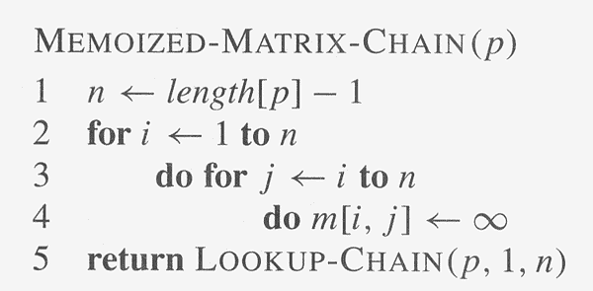
Memoized Matrix Chain
LOOKUP-CHAIN(p,i,j)
if m[i,j]<∞ then return m[i,j]
if i=j then m[i,j] ←0
else for k←i to j-1
do q← LOOKUP-CHAIN(p,i,k)+
LOOKUP-CHAIN(p,k+1,j)+p_{i-1}p_{k}p_{j}
if q< m[i,j] then m[i,j] ←q
return m[i,j]

Slide 26
DP VS. Memoization
MCM can be solved by DP or Memoized algorithm, both in O(n³).
  Total Θ(n²) subproblems, with O(n) for each.
If all subproblems must be solved at least once, DP is better by a constant factor due to no recursive involvement as in Memoized algorithm.
If some subproblems may not need to be solved, Memoized algorithm may be more efficient, since it only solve these subproblems which are definitely required.

Slide 27
Summary
DP two important properties
Four steps of DP.
Differences among divide-and-conquer algorithms, DP algorithms, and Memoized algorithm.
Writing DP programs and analyze their running time and space requirement.
Modify the discussed DP algorithms.

Slide 28
References
cs.iupui.edu/~xkzou/teaching/CS580/DynamicProgramming.ppt

